Slide 1
Digital Capacity Management (DCM)
Test cases for the TTR IT Implementation Pilot
September, 2022

Slide 2
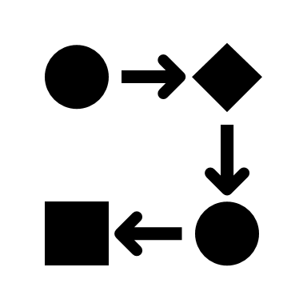
Test case categories
Create object
Update object
Change the status of the object
Feasilibity Study
Simulate process according to TTR deadline
Path Modification
Path Alteration
Notes:
Create object: like CM, CN, TCR
Update object: like CM, CN, PA
New path request according to the TTR deadlines

Slide 3
Test case list (candidates)
Create capacity model for a line manually
Import capacity models for a line
Create capacity model for the borderline
Coordinate capacity models for the border crossing
Create capacity model variants for the line
Reference the CNA in the CM
Reference more CNAs in the CM
Searching for the CM per various parameters

Slide 4
Test case list (candidates)
Create catalogue path for freight train without offset on the route
Create catalogue path for freight train with offset on the route
Create catalogue path for passenger train without offset on the route
Create catalogue path for passenger train with offset on the route
Update train parameter (Train weight, train length, planned speed, container profile) of an existing catalogue path
Update timetable of an existing catalogue path
Shorten route of an existing catalogue path
Extend the route of an existing catalogue path
Update the calendar of an existing catalogue path
Update the train type of an existing catalogue path
Publish an existing catalogue path

Slide 5
Test case list (candidates)
Withdraw a published catalogue path
Create path for freight train without offset on the route
Create path for freight train with offset on the route
Create path for passenger train without offset on the route
Create path for passenger train with offset on the route
Update train parameter (Train weight, train length, planned speed, container profile) of an existing path
Update timetable of an existing path
Shorten route of an existing path
Extend route of an existing path
Update calendar of an existing path
Update train type of an existing path

Slide 6
Test case list (candidates)
Publish (=booked) an existing path
Withdraw a published path
Search for capacity products according different parameters
Feasibility study with 1RA - 1IM
Feasibility study with 2RA - 2IM
Feasibility study with 1RA - 2IM
Feasibility study with 2RA - 1IM

Slide 7
Test case list (candidates)
Path modification with 1RA - 1IM
Path modification with 2RA - 2IM
Path modification with 1RA - 2IM
Path modification with 2RA - 1IM
Path alteration with 1RA - 1IM
Path alteration with 2RA - 2IM
Path alteration with 1RA - 2IM
Path alteration with 2RA - 1IM

Slide 8
Feasibility Study test case (details)
Create dossier (RA)
Update dossier (RA): update existing sub-path, create new sub-path
Start Feasibility Study (RA)
Submit Feasibility Study Request (RA)
Update dossier (IM): update existing sub-path, create new sub-path
Release Feasibility Elaboration Conference (IM)
Update dossier (RA, IM)
Return to Feasibility Study Elaboration (IM)
Submit Feasibility Study Result (IM)
Acknowledge Feasibility Study Result (RA)

Slide 9
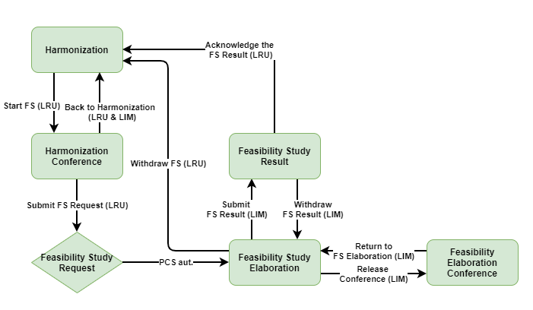
Feasibility Study process (PCS EC)

